Slide 1
DSC 333
Leak Detection System
By Connor Broderick

Slide 2

Project Objectives
Be able to detect water and notify someone of a leak to prevent potential water damage
Store data at regular intervals alongside current weather API data
Create an interactive dashboard to view the data

Slide 3
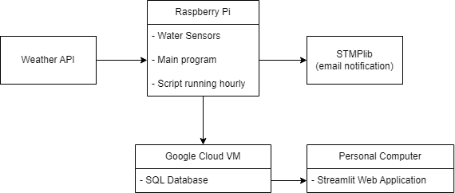
Application Structure

Slide 4
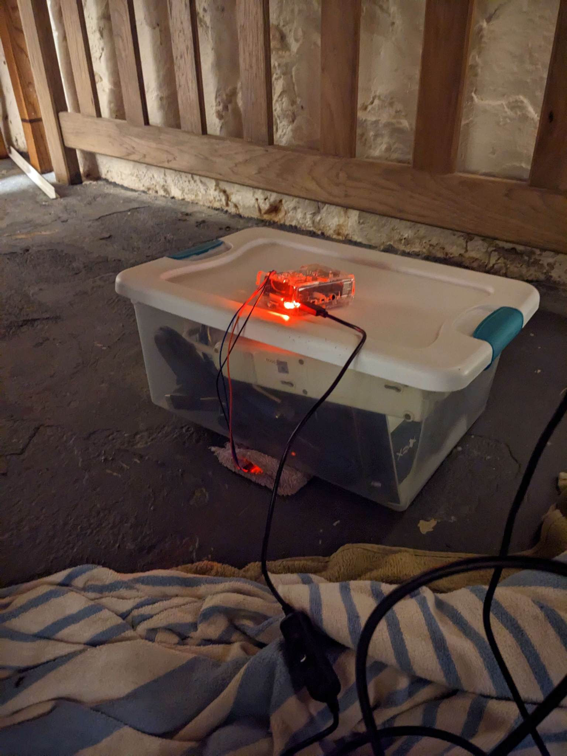
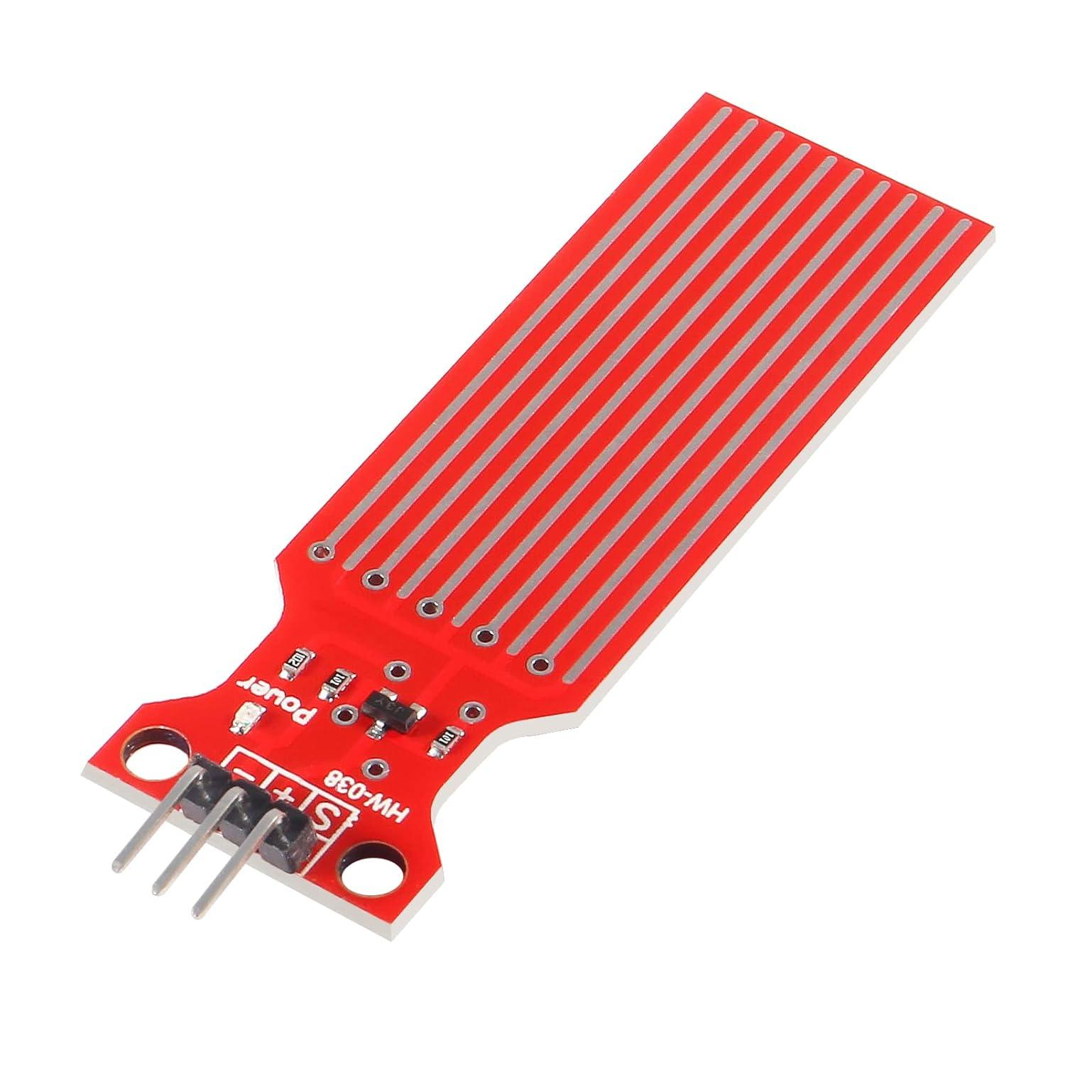
Setup Picture

Slide 5
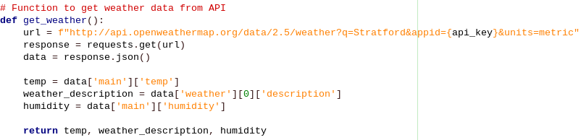
Weather API Data
Uses OpenWeatherMap’s API to get the current weather from my town
60 API calls per minute and 5 day forecast for free

Slide 6
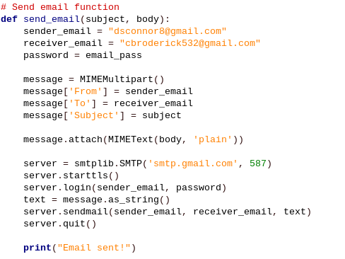
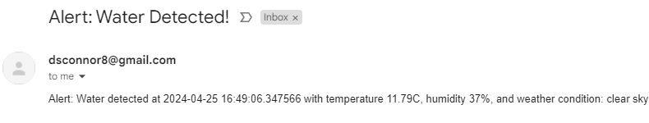
Sending Email Notifications
SMTPlib is a library that allows you to easily send emails using python
Uses MIME (Multipurpose Internet Mail Extensions) to format it
If water is detected, an email is sent

Slide 7
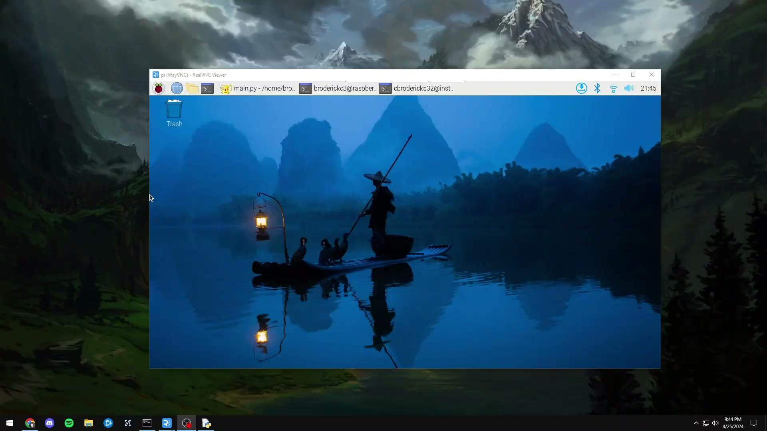
Demo Video

Slide 8
Conclusion
It is very easy to implement a useful automation program using a Raspberry Pi
With the short time frame this is more of a proof of concept, I wasn’t able to test it with actual leaks but it would work in its current state
With enough data collected, predicting leaks and warning of high risk is an option
My biggest problem is that leak locations change

Slide 9
Thank you
Any questions?

